Slide 1



SIFT FOR IMAGE STITCHING
Nazariy Bachynsky
Notes:
I’ll speak about and sift and image stitching and other things.

Slide 2


DO SOMETHING WITH IMAGES…
Notes:
Originally topic of my project sounded like “do something with images” – I was interested in it, but I didn’t know what to do. Someone recommended me “image stitching”. I thought “yeah, that’s cool, why not?”.

Slide 3
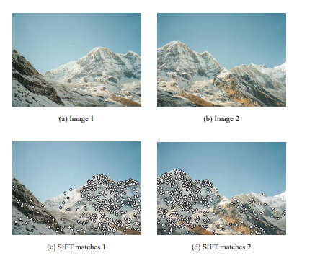

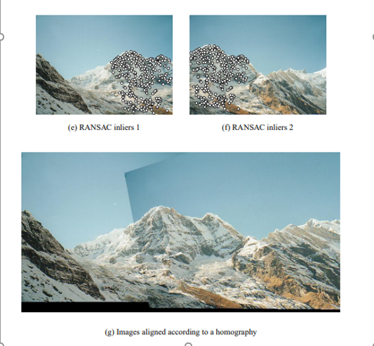
IMAGE STITCHING
Image stitching or photo stitching is the process of combining multiple photographic images with overlapping fields of view to produce a segmented panorama or high-resolution image
Notes:
So, what does it do? As input, we have, for example, two images, which can be rotated or scaled in anyway.
The first step is to detect such points on image that can detected even rotation or scale of the image will be changed. The most corners are so.
Then it is needed to match common points for images if they exist.
And… not so cool, now. Actually, it just needs a little more time then one term, and I’ll tell you SIFT which is literally the complete independent topic and will show what I’ve done.

Slide 4

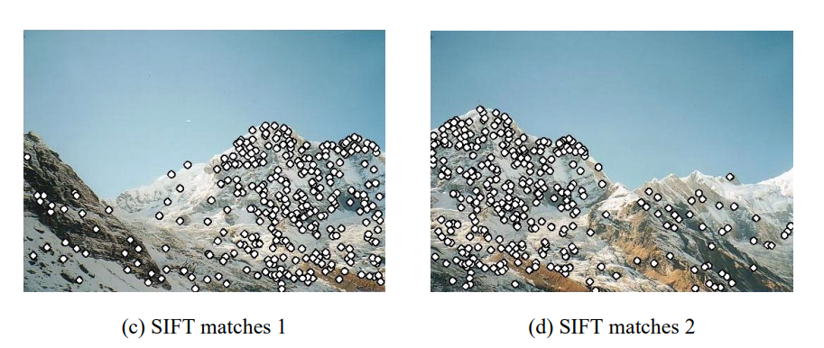
SIFT
Scale Invariant Feature Transform
Scale-space extrema detection
Keypoint localization
Orientation Assignment
Keypoint Descriptor
Notes:
As I already mentioned, there is necessity to find scale- and rotate-invariant points which are called keypoints. Firstly, we search for potential keypoints. That is, corners and edges. Then we filter points which are close to each other or have low contrast from candidates. And, after all of these, we need to describe that keypoints with descriptors. But everything is in order.

Slide 5
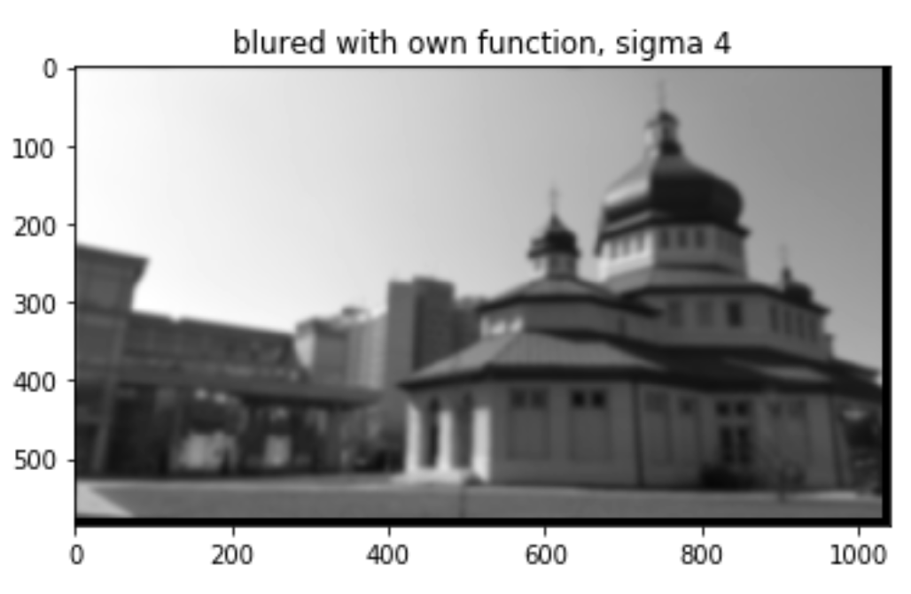
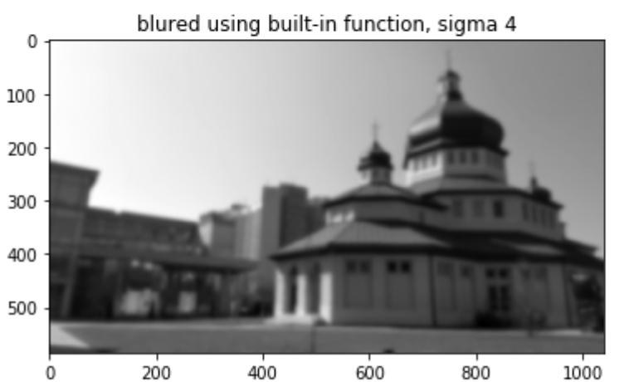
GAUSSIAN BLUR
A little remark
Notes:
Some words about Gaussian blur. I have implemented this filter. Here is result of its work and result of built-in function. Both are called with sigma equal to four. Pretty good, I think.

Slide 6

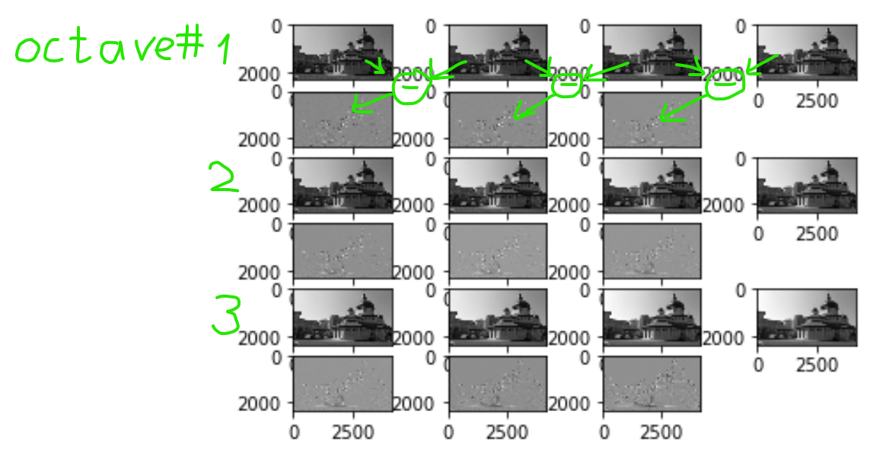
Differences of Gaussians (DoG)

Slide 7
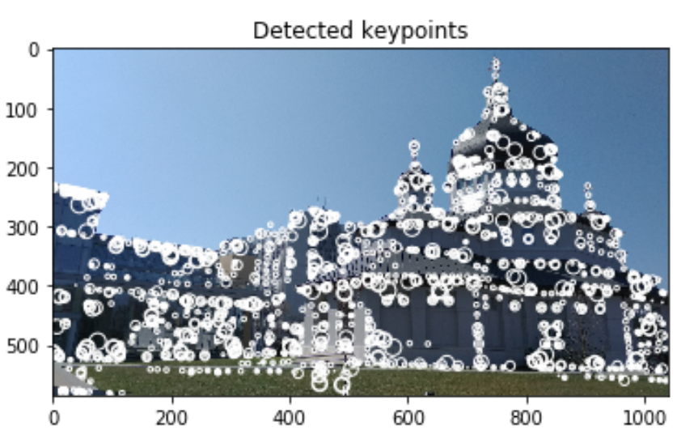

Slide 8
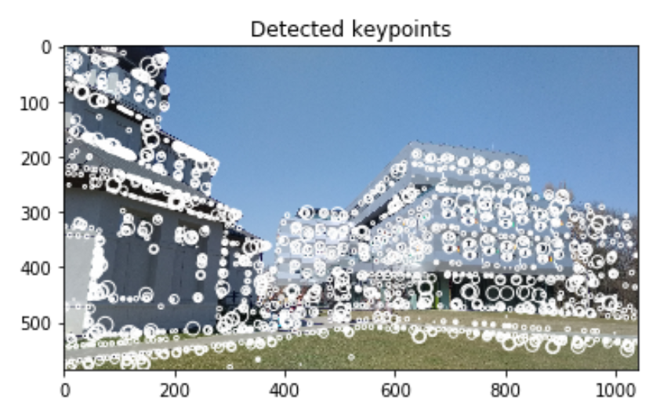

Slide 9
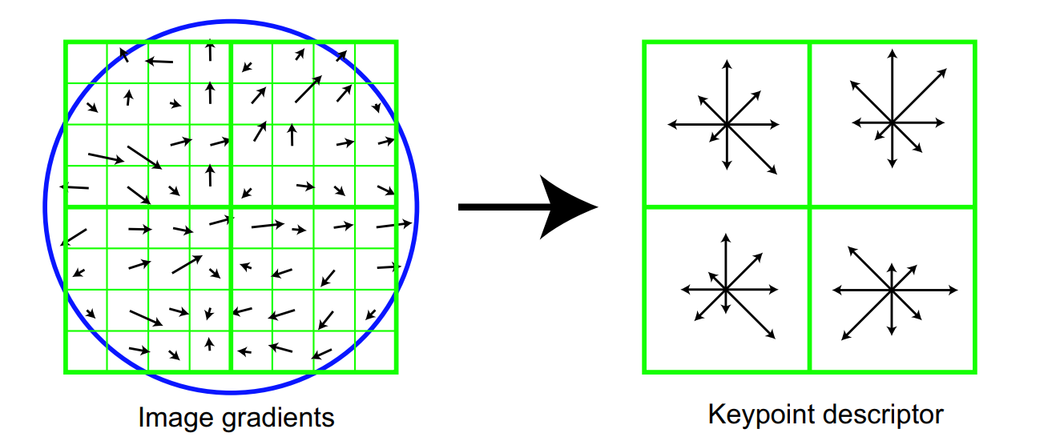

KEYPOINT DESCRIPTOR
Is made from image gradients’ magnitudes and orientations

Slide 10

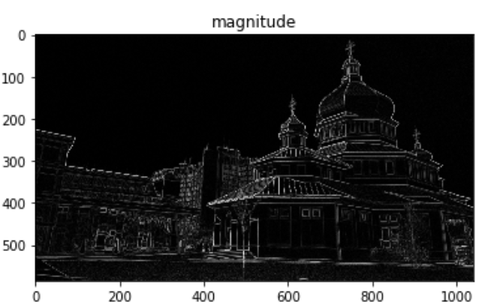
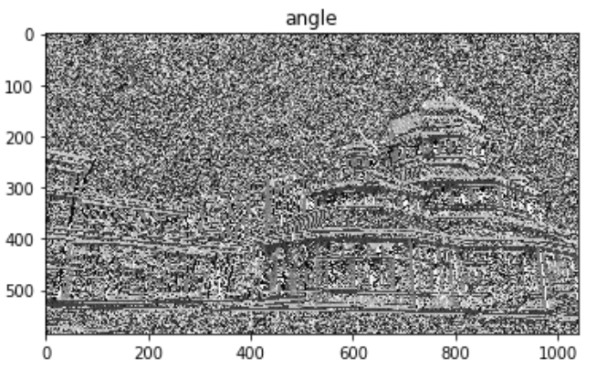
GRADIENTS

Slide 11
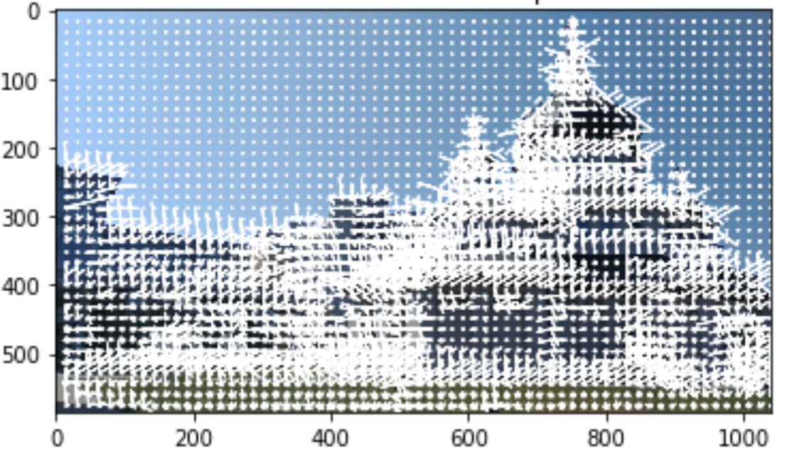
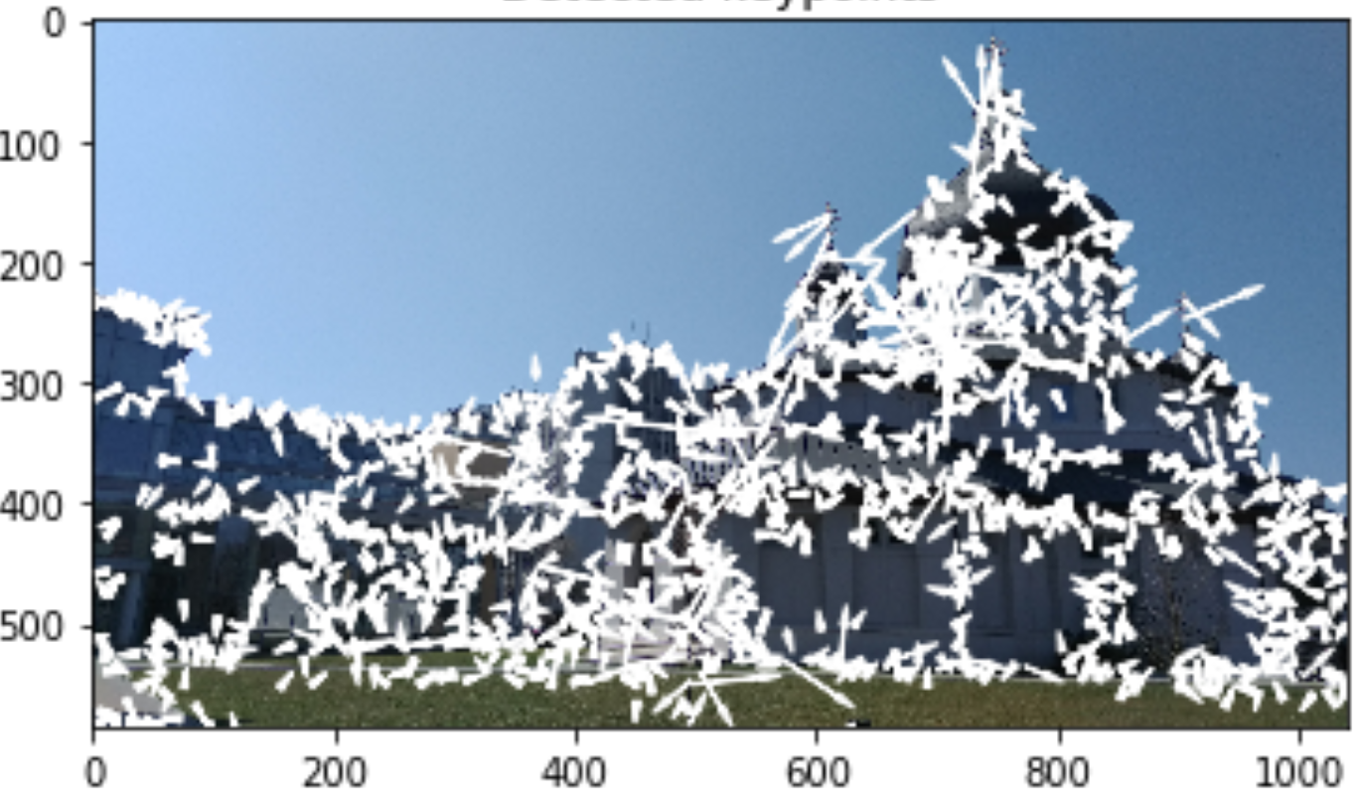
GRADIENTS

Slide 12
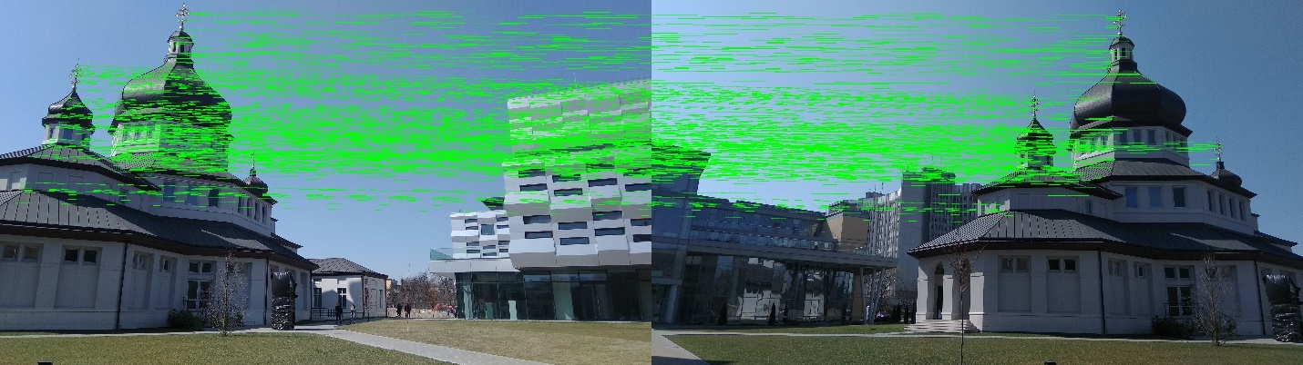

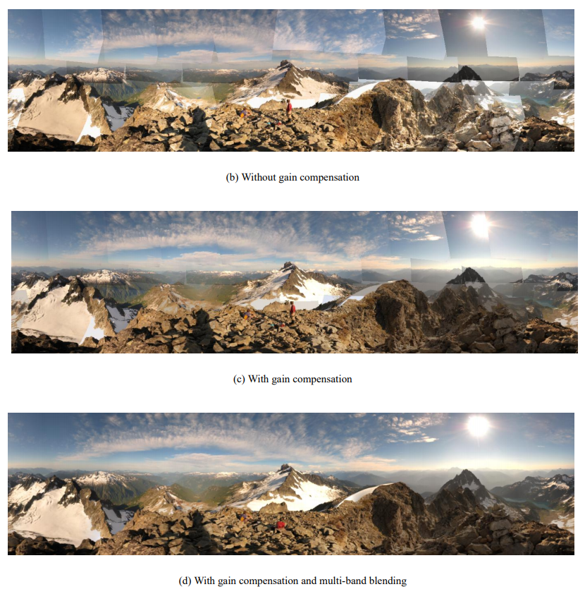
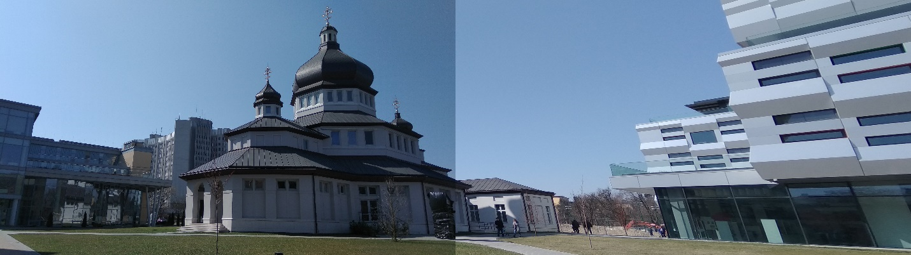
SUMM ARY ER
The next things to do

Slide 13
THORNY WAY
March
Gaussian Blur
THINGS THAT ARE MADE
April
Difference of Gaussians
May
Image gradients
May
Feature Descriptors

Slide 14
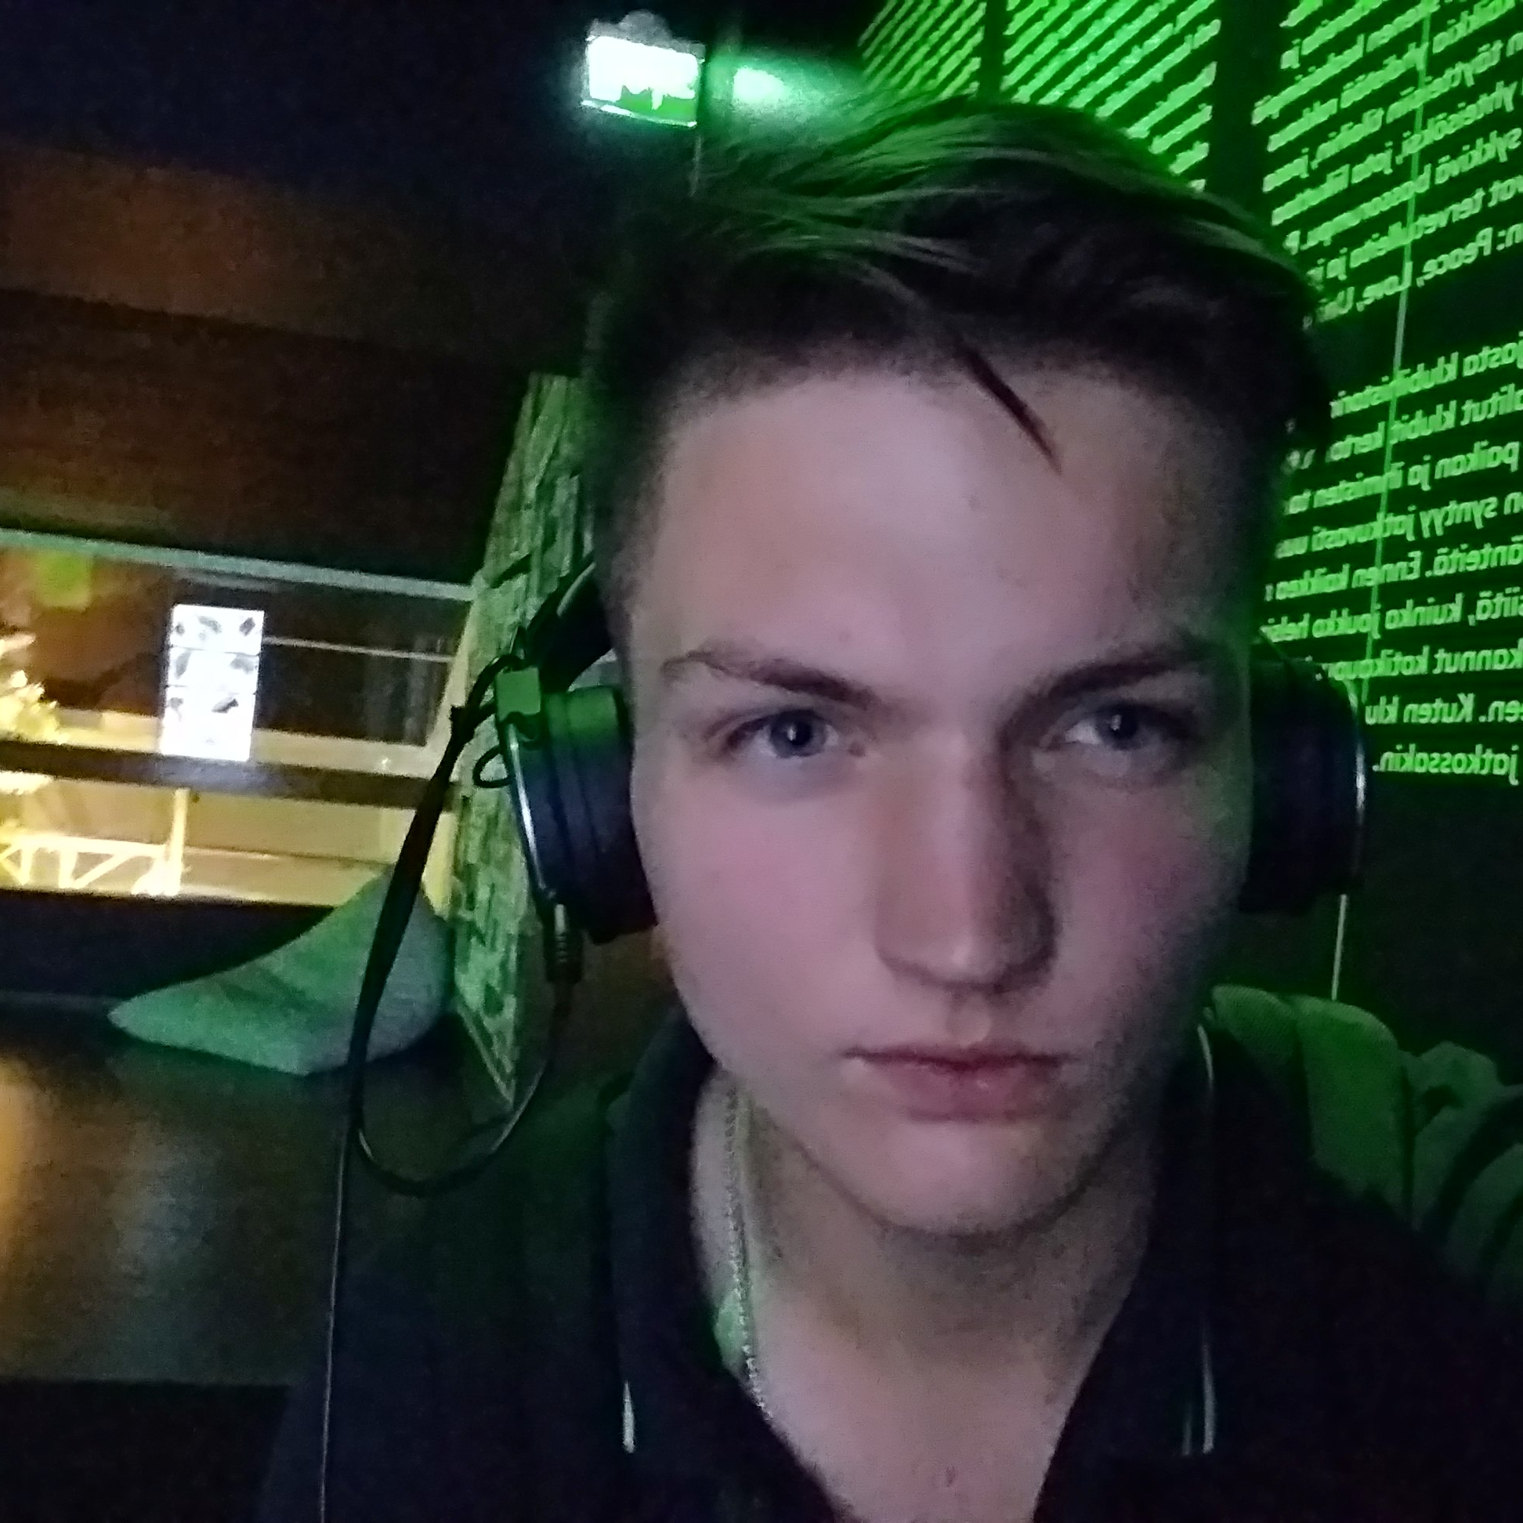
OUR TEAM
Nazariy Bachynsky
Team Core
Does all stuff

Slide 15
Any questions?
Thanks for attention!

